Slide 1
EMERGENCY MANAGEMENT AND
EVACUATION PROCEDURES

Slide 2


Slide 3
TYPES OF EMERGENCIES
Structural fire (onsite)
Bushfire approaching
Weather event (storms, wind, heatwave, dust)
Dangerous levels of air quality
Bomb threat
Dangerous animal or person on premises
Chemical spill

Slide 4
INITIAL RESPONSE IS “RACE”
RESCUE – if safe to do so! Ensure the safety of self and others in immediate vicinity.
ALARM – call 800 to alert the Critical Response Team. General medical assistance should be directed to ‘First Aid’ (call 111).
CONTAIN – use fire extinguishers / blankets, shut doors, if safe.
EVACUATE – follow instructions in announcements (listen carefully, don’t lock doors on exit, take laptop/paper list for roll call, move to netball courts).

Slide 5
EVACUATION DURING CLASS TIME
Staff who are teaching:
Turn off any equipment that may be a hazard
Direct students to the nearest safe exit
Make a final check, take your laptop/class roll, leave the door open
Lead students to the Emergency Evacuation Point (netball courts) avoiding
any unsafe spaces or areas of concerns
All Staff who are NOT teaching:
Report to the Chief Warden at the Emergency Control Point (Front office)
Assist staff to evacuate students safely via the closest safe exit, assisting those with additional needs or disabilities
Assist to ensure that all spaces have been evacuated in your allocated area

Slide 6
EVACUATION DURING RECESS/LUNCH
Yard Duty Staff are to move to the Emergency Evacuation Point (netball courts):
Gather any students still in the yard moving them towards the Evacuation Point
Teaching Staff are to move to the Emergency Evacuation Point (netball courts):
If any students are in classrooms direct them to the nearest safe exit
Make a final check, take your laptop/class roll and leave doors open
All Non-Teaching Staff:
Report to the Chief Warden at Emergency Control Point (Front Office)
Assist staff to evacuate students via the closest safe exit, assisting those with additional needs or disabilities
Assist to ensure that all spaces have been evacuated in your allocated area

Slide 7
EMERGENCY EVACUATION POINT:
All teaching staff to bring your class to Emergency Evacuation Point. All other staff move to Front Office to assist as Wardens
Line students in year levels
Teacher to mark roll and inform the Comms Officer
Year Levels in numeric order
Wait with your class until the all clear is given by the Chief Warden
Students are to remain seated in their class groups
Preps exit via front gate, Years 1-3 via playground gate, Years 4-6 via uniform shop gate

Slide 8
LOCKDOWN
A lockdown will be confirmed via a PA announcement
DURING RECESS/LUNCH:
All staff on yard duty are required to open the closest rooms for students to move to ensuring that there is a staff member present
Teaching staff assist with students in nearby classrooms
DURING CLASSTIME:
Remain with your class
When inside:
Lock all doors/windows, draw any blinds and curtains and remain inside
Keep students inside and sit down on the floor together away from windows/doors
Monitor your phone/email to ensure you are receiving communication
Give students reassurance, help them to remain quiet and calm
Do not allow students on devices to ensure they are not emailing their parents or creating a sense of panic amongst the community which wastes important time and/or resources of emergency services trying to resolve the situation
Wait for further instructions from the Chief Warden via email/phone/PA

Slide 9
KEY ROLES IN AN EMERGENCY
All Staff not in the act of teaching are to report to the front office as a Warden.
All Wardens are to be ready to follow instructions from the Critical Response Team (Leadership Team/Chief Warden).
The Communication Officer records information during the emergency, not admin team. It’s a designated person by the Chief Warden.
Incident control is handed over to the emergency services when they arrive

Slide 10
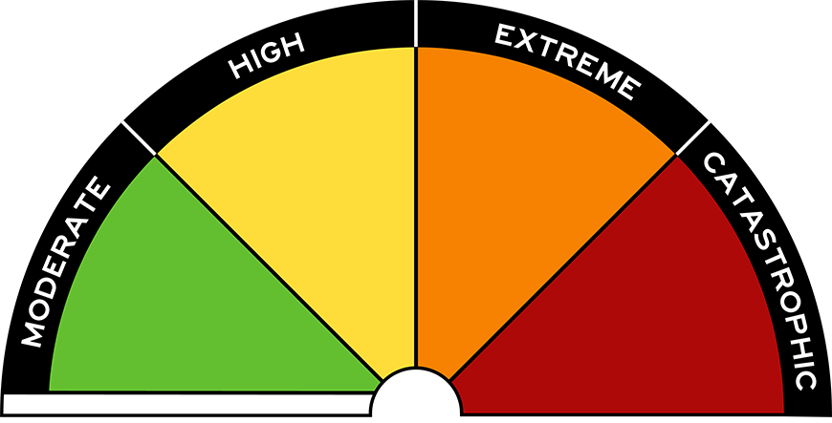
CATASTROPHIC WEATHER DAY
St Patrick’s is not listed on the Bushfire At Risk Register and is not required to close on Catastrophic-rated days. However there are schools on this list in nearby Romsey and Lancefield.
In the event of a Catastrophic-rated day, any offsite activities in the rated areas will be cancelled or postponed.
Bus routes may need to be cancelled or rescheduled.
Stay informed through email, text, website, social media for latest updates/ information

Slide 11
THANK YOU!

